Slide 1


IRONCASINO
GAMBLING
ANALYSIS

Slide 2


IRONCASINO
ISABELLA MESQUITA
JOÃO STOCK
JAVIER
MARTINEZ

Slide 3

CONTENT INDEX
Customer group per country
Expenses by customer and service
Recomendations

Slide 4
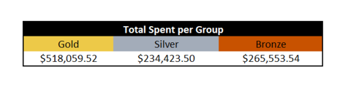

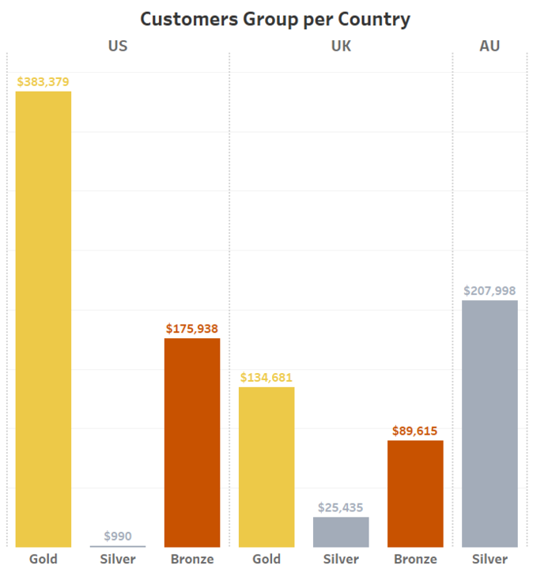
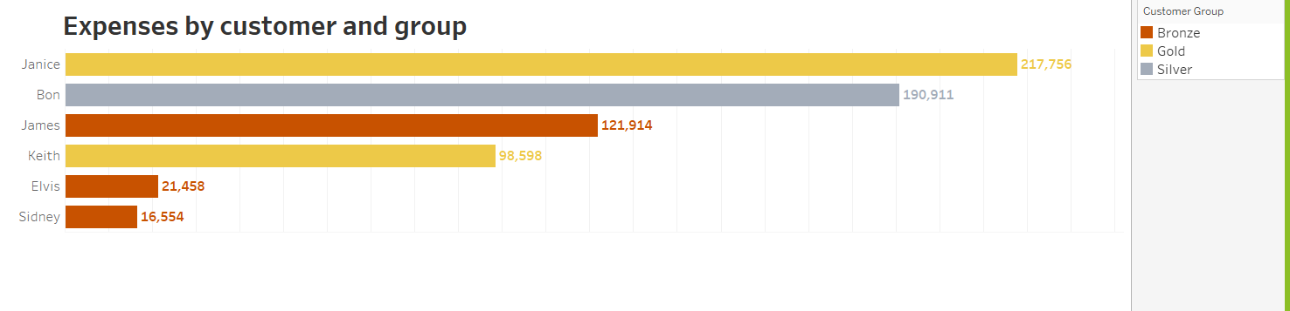

Slide 5
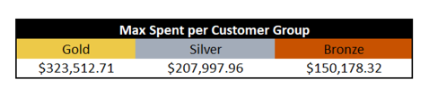
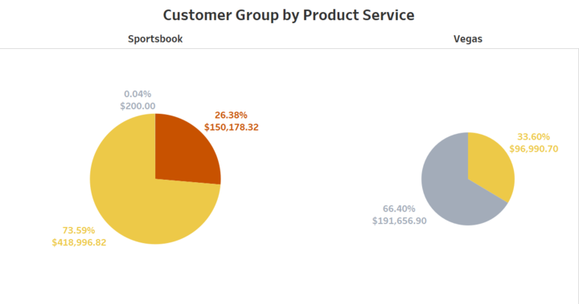
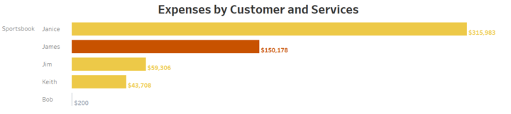
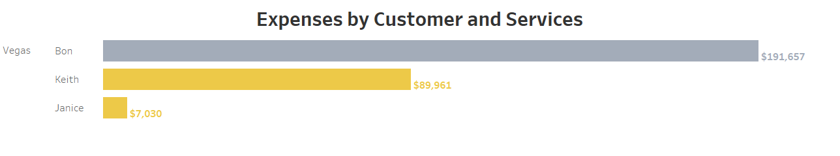

Slide 6


RECOMENDATIONS
1
REVIEW
The Silver group, led by Austrialians is mostly concentrated on Vegas games and is heavily driven by a single customer, which means that investing in Vegas over sportsbook might not be a good idea.
2
IMPROVEMENTS
A divison of the groups might be reviewed as we have silver and bronze clients spending much above the bronze clients
3
GOLD GROUP
Try review the criteria for customer segmentation.

